Slide 1
C PROGRAMMING FOR EMBEDDED SYSTEMS
EL-GY 6483 REAL TIME EMBEDDED SYSTEMS

Slide 2
C FOR EMBEDDED
Language | Programmers
C | 60%
C++ | 21%
Assembly | 5%
Java | 3%
C# | 2%
MATLAB/Labview | 4%
Python | 1%
.NET | 1%
Other | 4%

Slide 3
C FOR EMBEDDED
Some differences in programming for embedded systems:
Compiling for a different target architecture
Limited memory, processing power on target
Can have input from external peripherals
Reliability constraints

Slide 4
LIFECYCLE OF A C PROGRAM FOR EMBEDDED

Slide 5
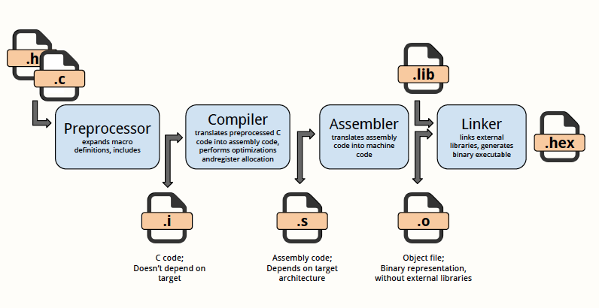
HOW C CODE BECOMES AN EXECUTABLE

Slide 6
SPECIFICS

Slide 7
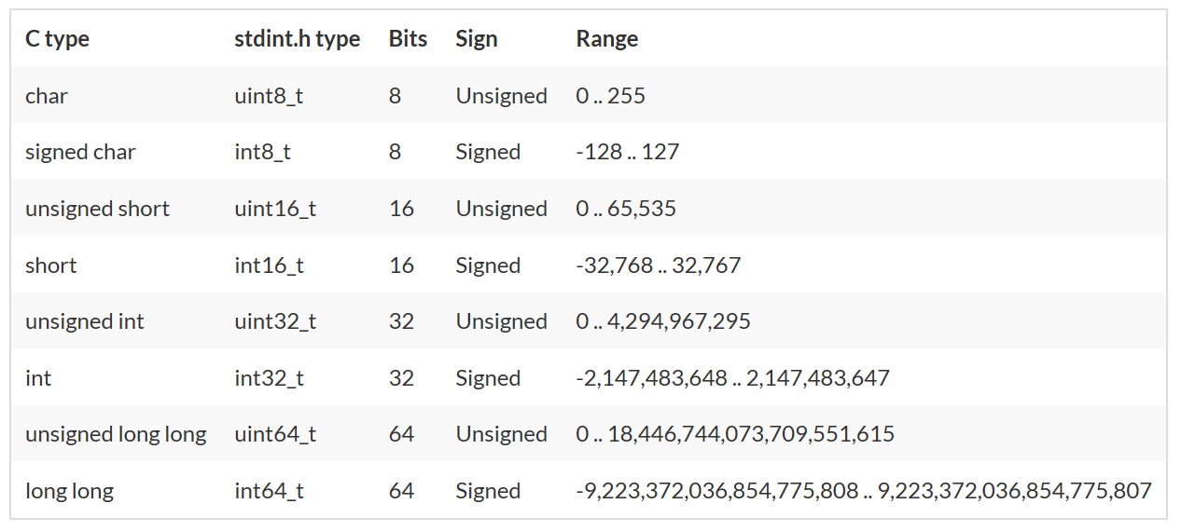
DATA TYPES

Slide 8
BITWISE OPERATIONS
Bitwise operation | Symbol (in C)
AND | &
OR | |
XOR | ^
NOT | ~
Left Shift | <<
Right Shift | >>

Slide 9
EXAMPLE: CHECK A BIT
To check a bit, AND it with the bit you want to check:
bit = number & (1 << x);
That will put the value of bit x into the variable bit.

Slide 10
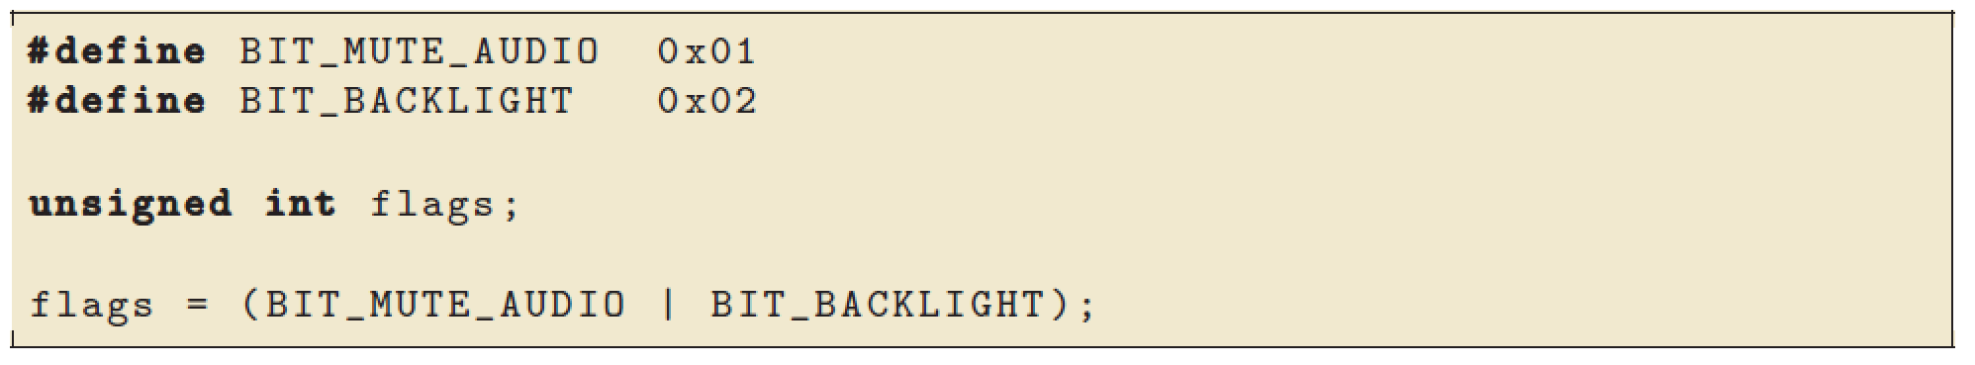
BIT FIELDS
To create a mask of certain bits.

Slide 11
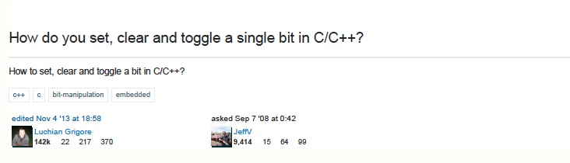
BIT OPERATIONS: EXERCISE
Answer the following question for C, using bitwise operators:

Slide 12
IMPLIED DECLARATION
int n = 0x7F2;
int n = 0b1010;
int n = (1<<3);

Slide 13
EXAMPLES
0x05 & 0x01 = ?
0x05 | 0x02 = ?
0x05 ^ 0x01 = ?
0x05 << 2 = ?
0x05 >> 1 = ?
0xF4 & 0x3A = ?
(1<<19) | (1<<12) = ?

Slide 14
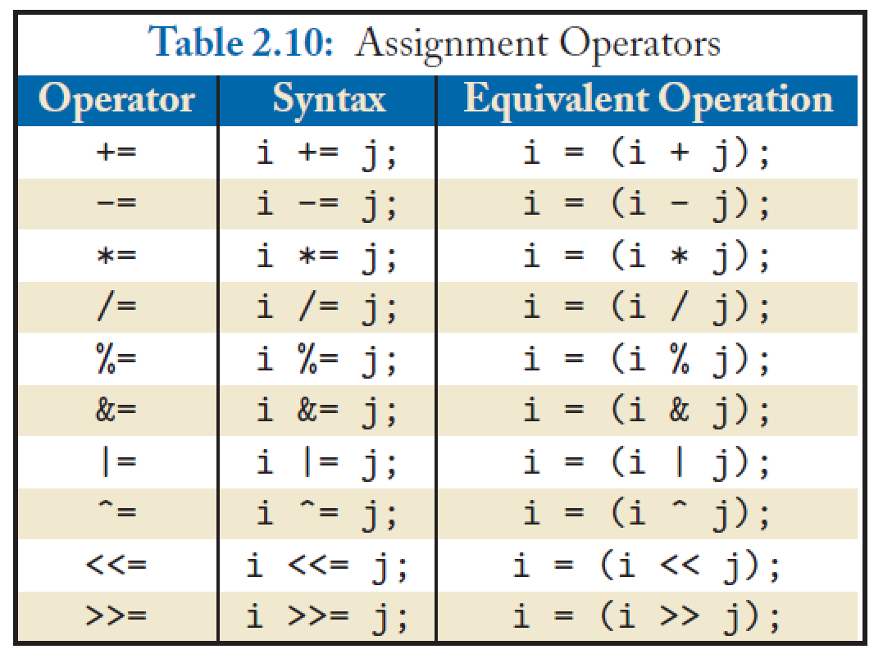
ASSIGNMENT OPERATIONS

Slide 15
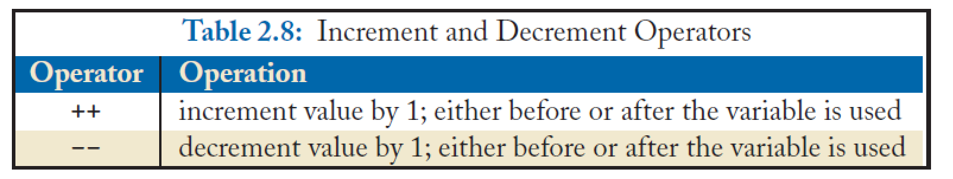
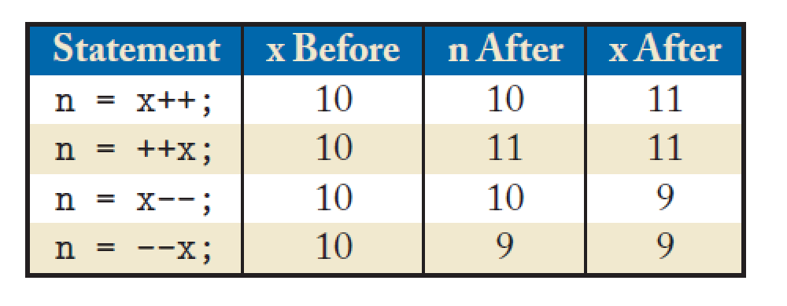
INCREMENT/DECREMENT OPERATIONS

Slide 16
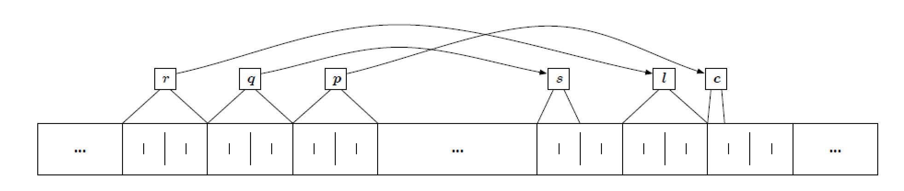
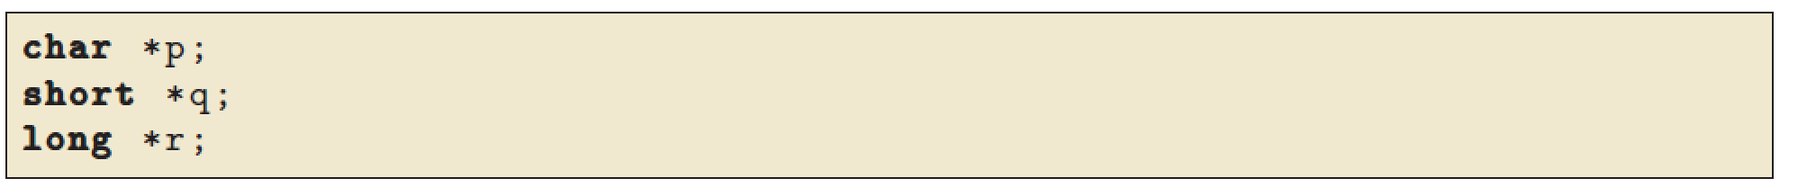
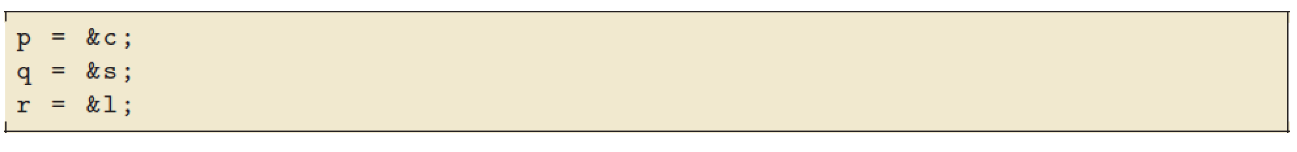
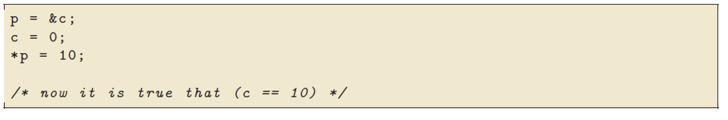
POINTERS

Slide 17
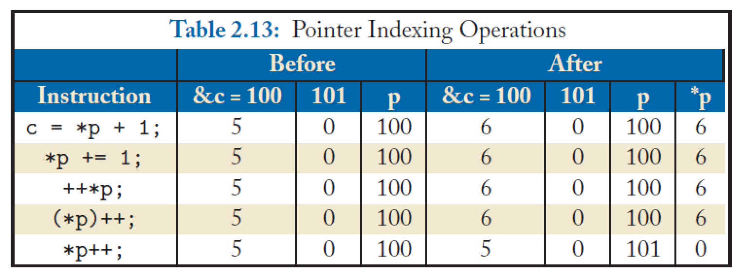
POINTERS EXAMPLE

Slide 18
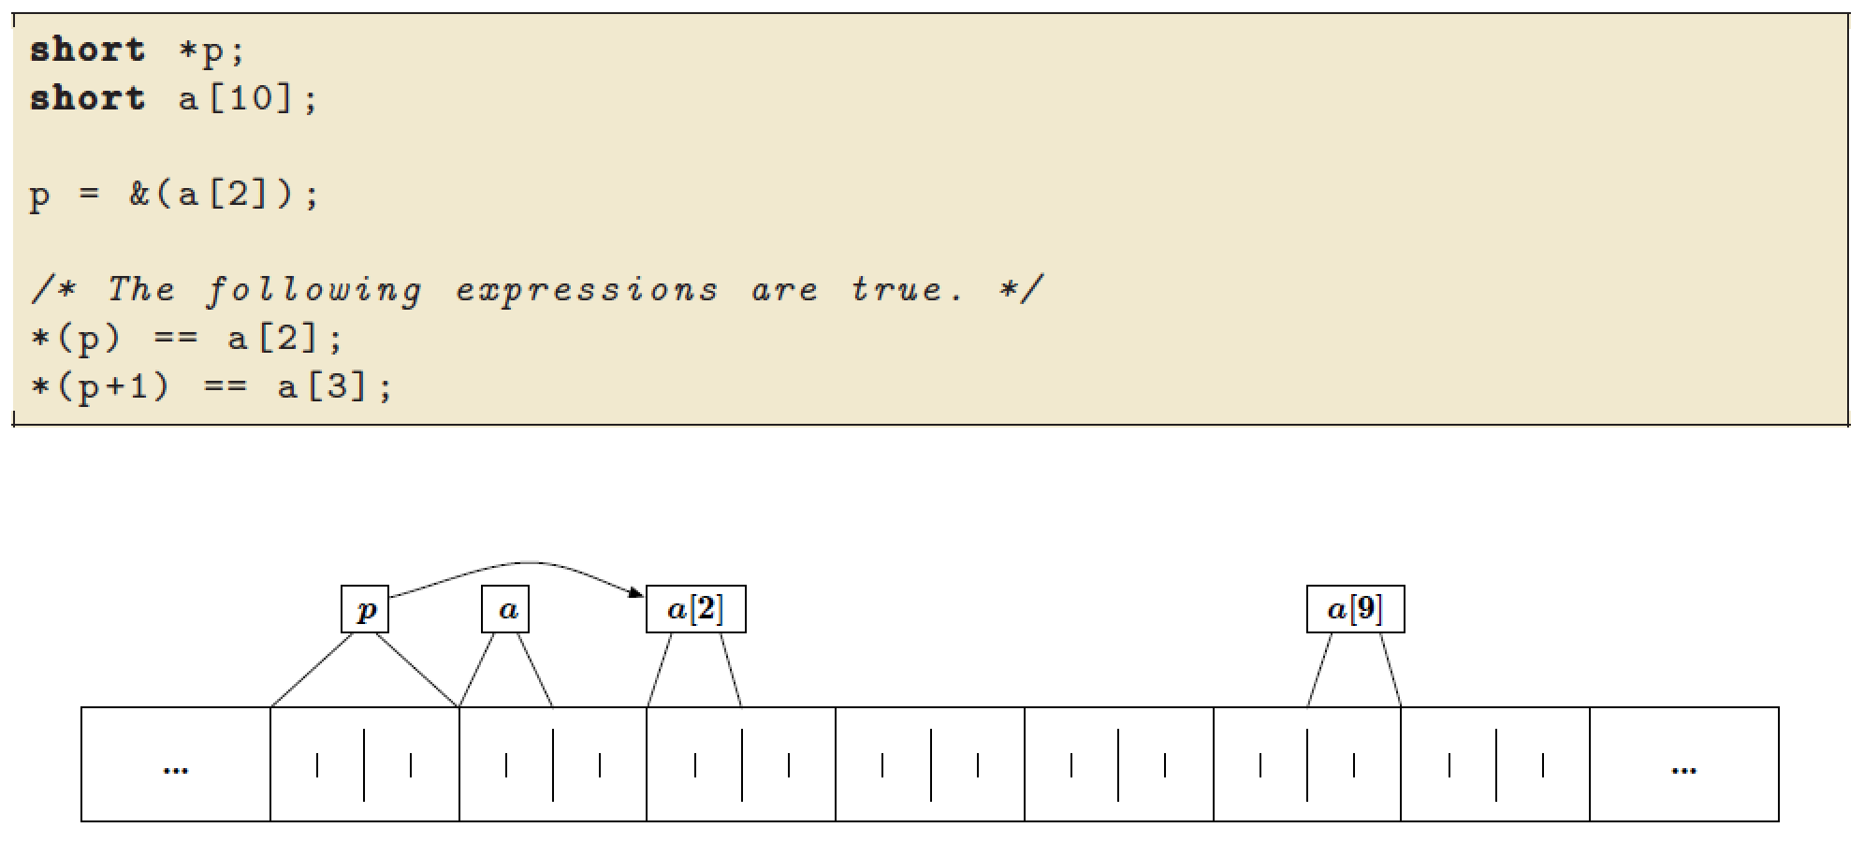
ANOTHER POINTER EXAMPLE

Slide 19
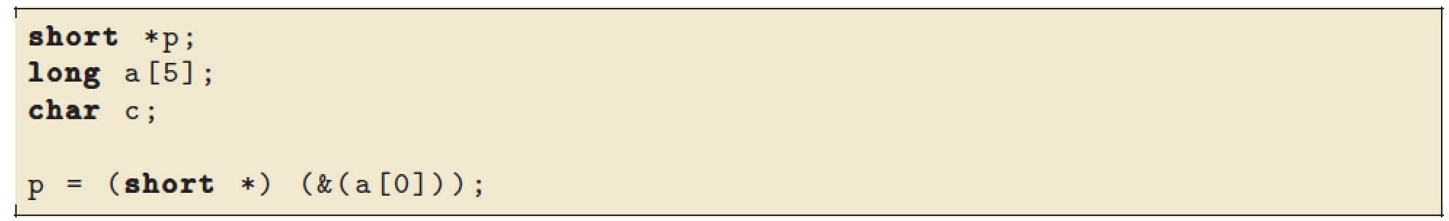
POSSIBLE??

Slide 20
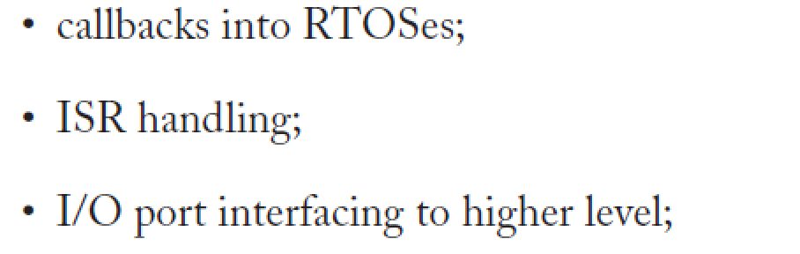
FUNCTION POINTERS, POSSIBLE??
Yes, but can be tricky.

Slide 21
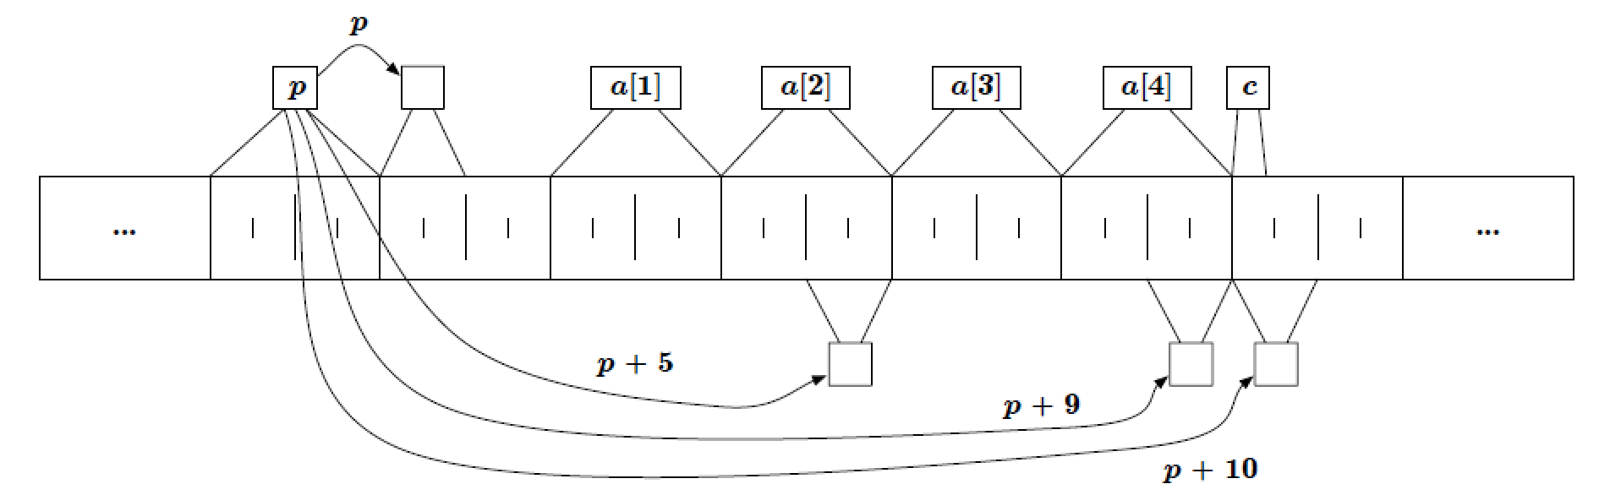
POSSIBLE?? - YES

Slide 22
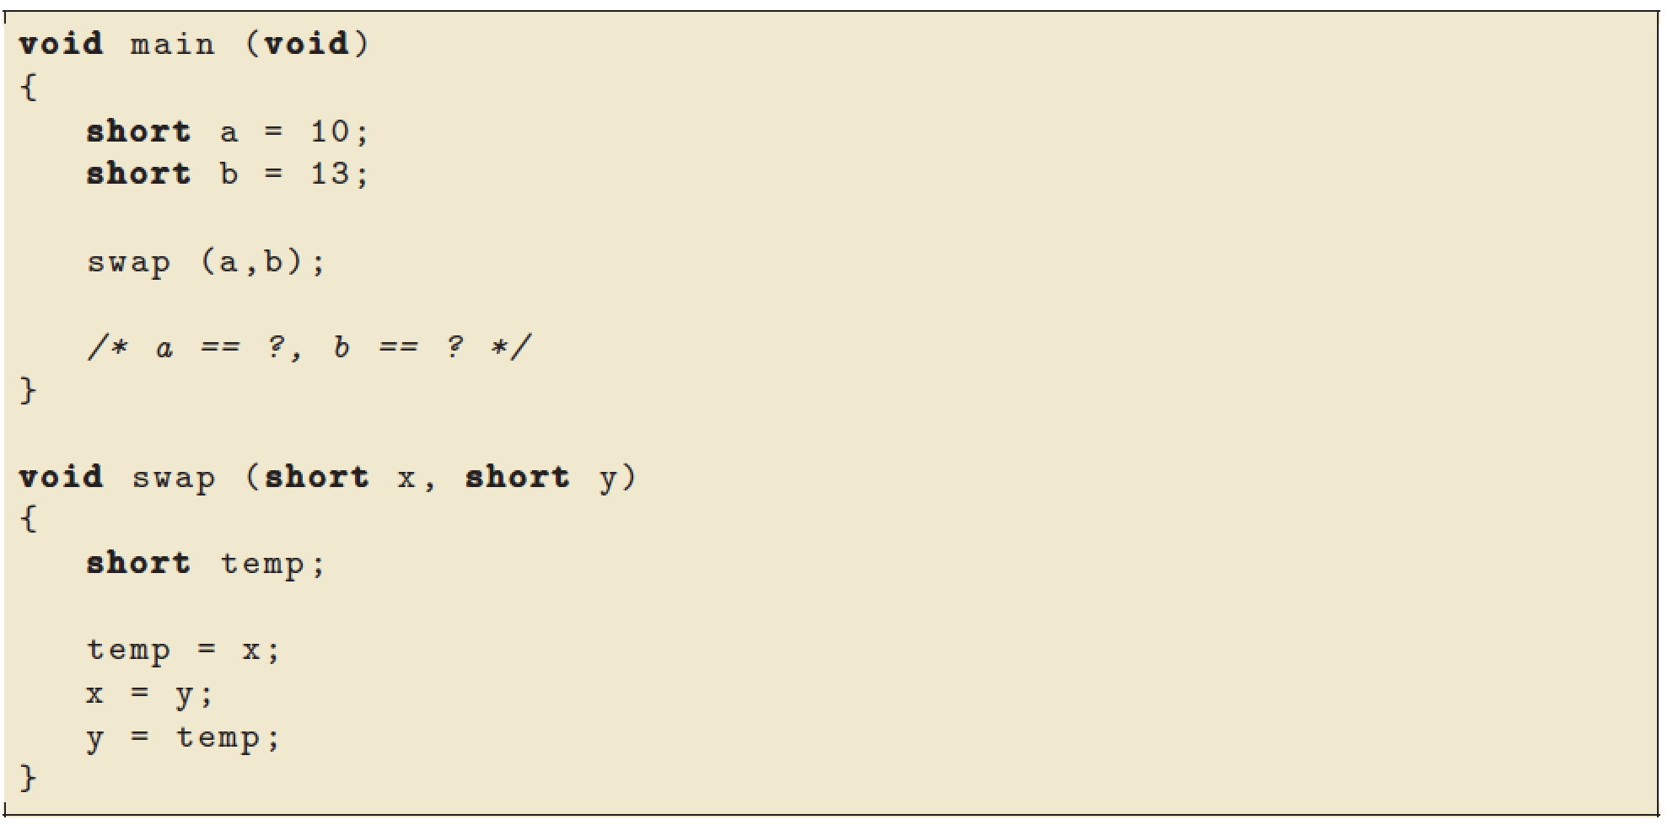
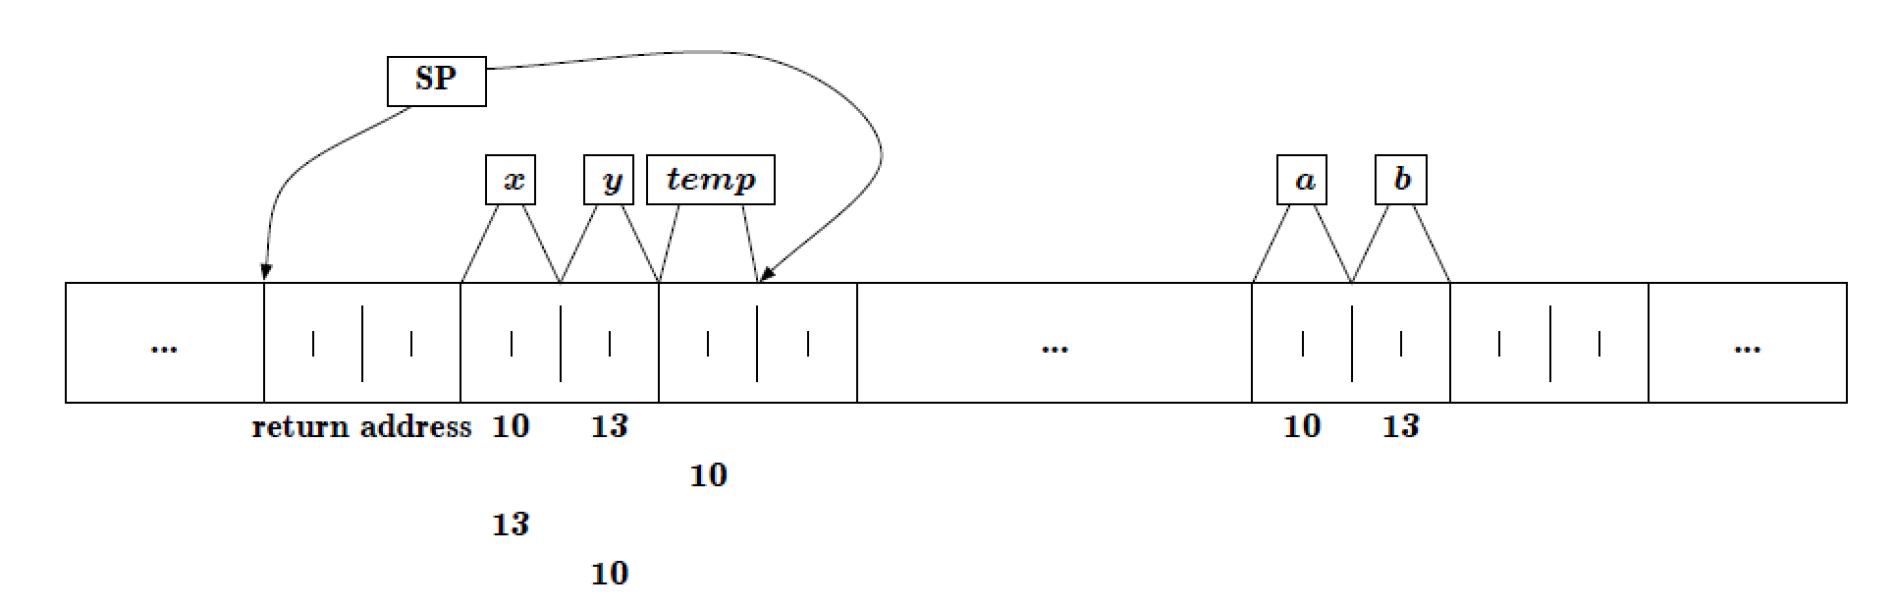
PASSING BY VALUE VS. REFERENCE

Slide 23
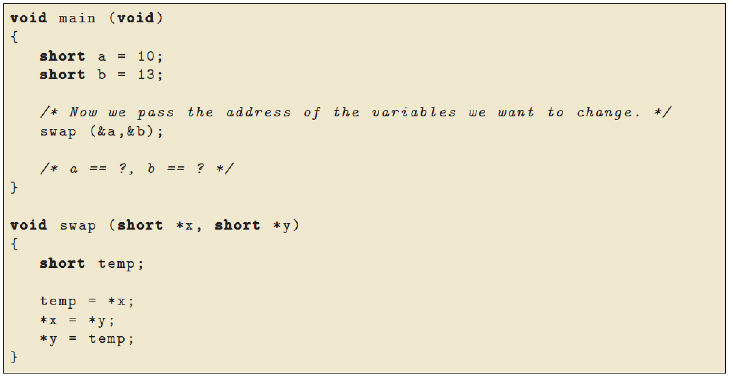
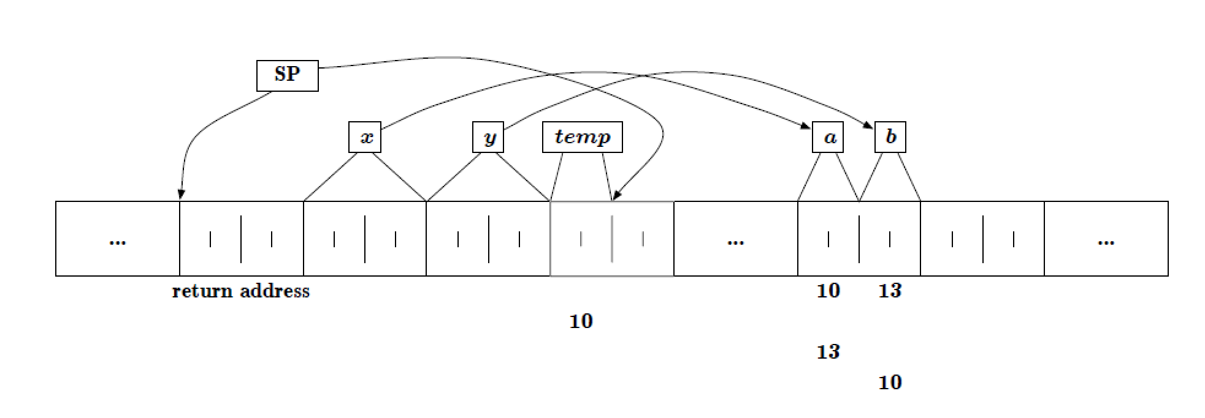
PASSING BY VALUE VS. REFERENCE

Slide 24
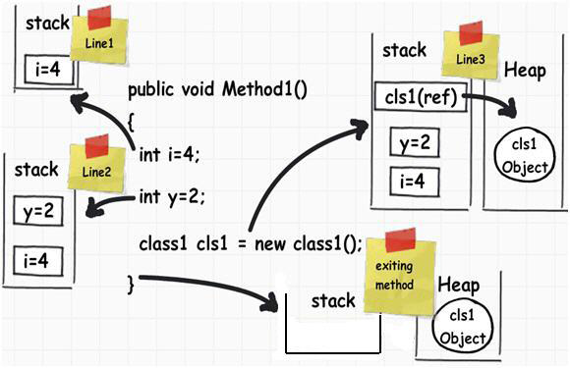
MEMORY MANAGEMENT
Source: ”What and where are the stack and heap?” Answer by Snow Crash, http://stackoverflow.com/questions/79923/ what-and-where-are-the-stack-and-heap

Slide 25
MEMORY MANAGEMENT
int foo() {
char *pBuffer; //<--nothing allocated yet (excluding the pointer itself, which is //allocated here on the stack).
bool b = true; // Allocated on the stack.
if(b)
{
//Create 500 bytes on the stack
char buffer[500];
//Create 500 bytes on the heap
pBuffer = new char[500]; }//<-- buffer is deallocated here, pBuffer is not
}//<--- oops there's a memory leak, I should have called delete[] pBuffer;
Source: ”What and where are the stack and heap?” Answer by Snow Crash, http://stackoverflow.com/questions/79923/ what-and-where-are-the-stack-and-heap

Slide 26
MEMORY MANAGEMENT
Some coding standards (e.g. for high-reliability embedded systems) forbid dynamic memory allocation. Why?

Slide 27
VOLATILE
We specify volatile variables when using interrupts and I/O ports
Tells compiler that variables can be changed outside of the code

Slide 28
VOLATILE
A programmer writes the following function to get the square of a volatile integer parameter pointed to by*p.
However, when he tests it, it returns ‘6’ – which is not a square of an integer value!
Why does this happen, and how can he modify his code so that it will always return a valid square?
int square(volatile int *p)
{
return *p * *p;
}

Slide 29
TYPE QUALIFIERS
When might we declare
const volatile int n;
?

